Slide 1
Testbeds for Cybersecurity Experimentation and Test
Terry Benzel
Director Networking and Cybersecurity Research
Information Sciences Institute
University of Southern California

Slide 2
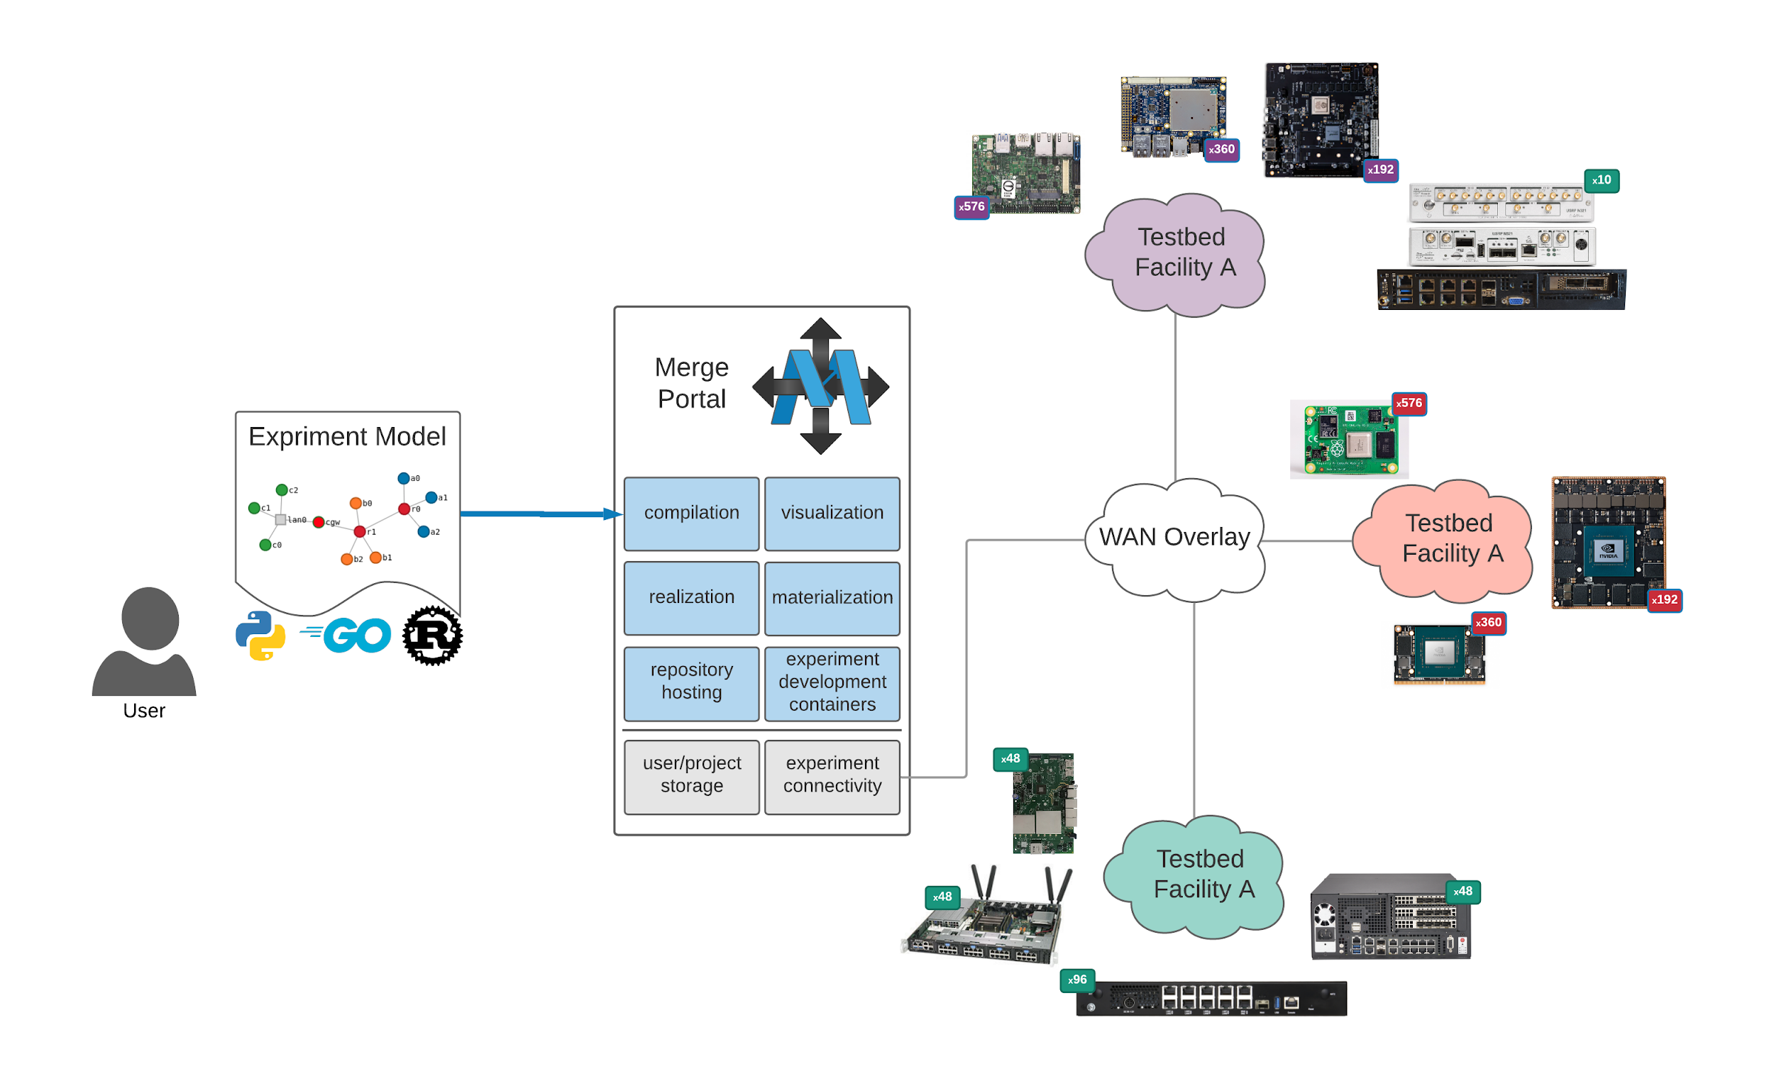
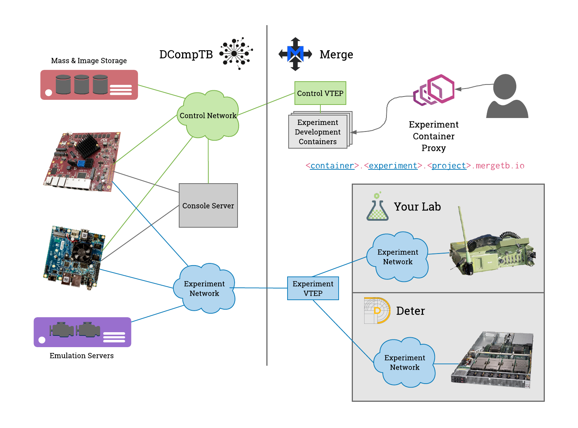

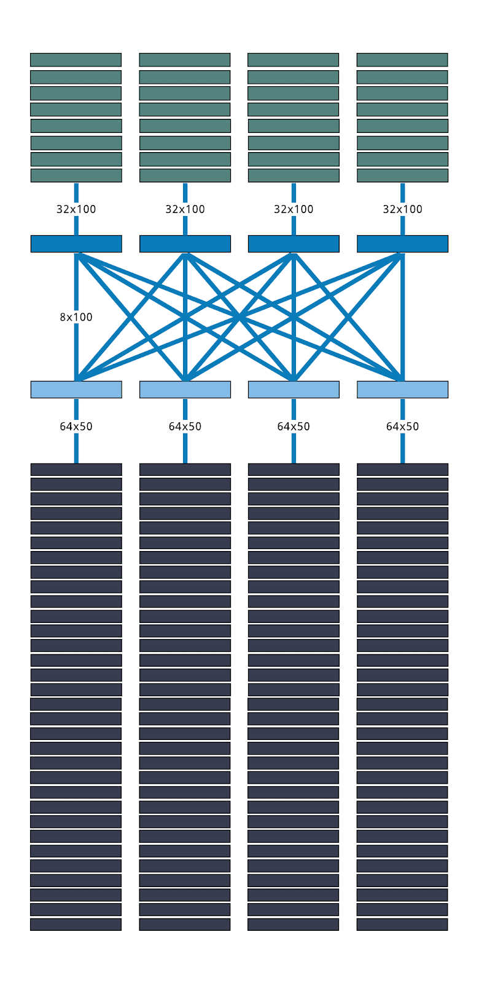
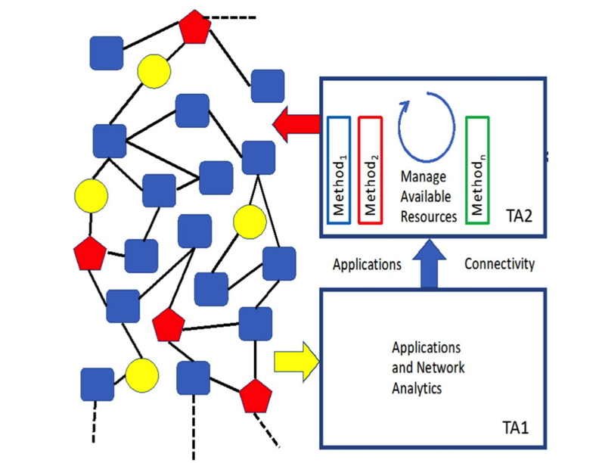
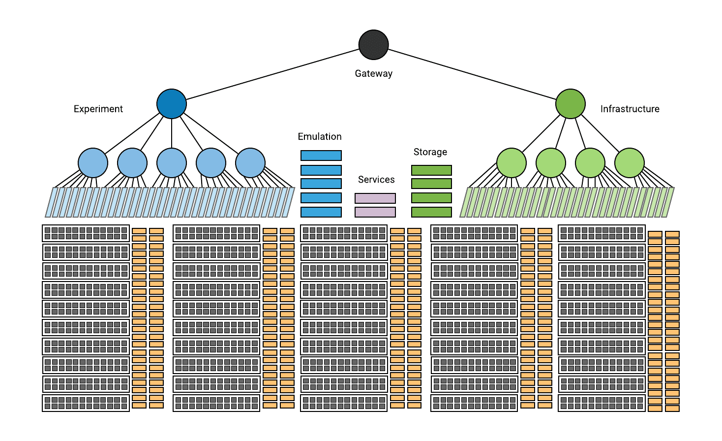
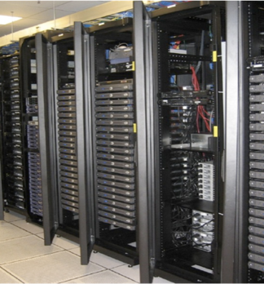
Testbeds for Cybersecurity Experimentation
Leveling the playing field
Network Testbeds
Merge: Ecosystem of Testbeds
The entire world is a testbed for the adversary
They operate with endless time, largely undetected
National roadmap for Cyber Experimentation of the Future
Teaming Partners: InferLink, Duality, Lumen, CRA, CEA, Symantec, CenturyLink, Universities
International Partners: Experimental Facilities adopted by Singapore, Israel, EU-JRC, Netherlands
Evaluation Scenarios for several DARPA programs
Technology Demonstration and Transition
DETER Cybersecurity Testbed​
Dcomp Testbed
SearchlightTB:
Enterprise Control of
Application QoS at
Scale
Experimentation Platform algorithms/
protocols, harness physically dispersed boost application and network transport
performance by orders of magnitude
1444 nodes
1200 minnow
240 rohu
4 ahi
77 switches
5 emulation servers
4 storage nodes
Emulation,
Experimentation
Education
Dual Xeons
40G/100G NICs /node
ConnectX-5 NIC
Mellanox Spectrum 2
Terry Benzel
Director Networking and Cybersecurity Research

