Slide 1
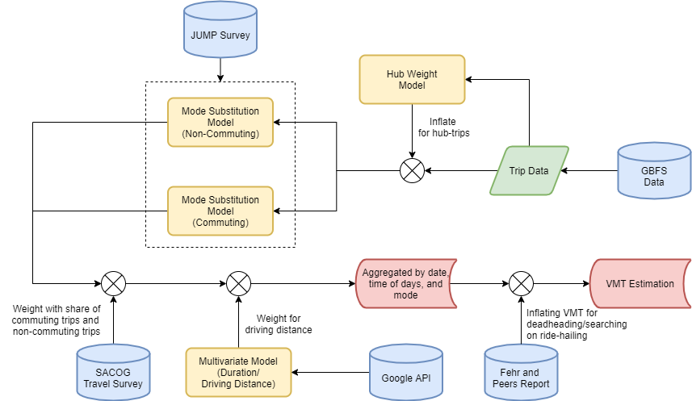
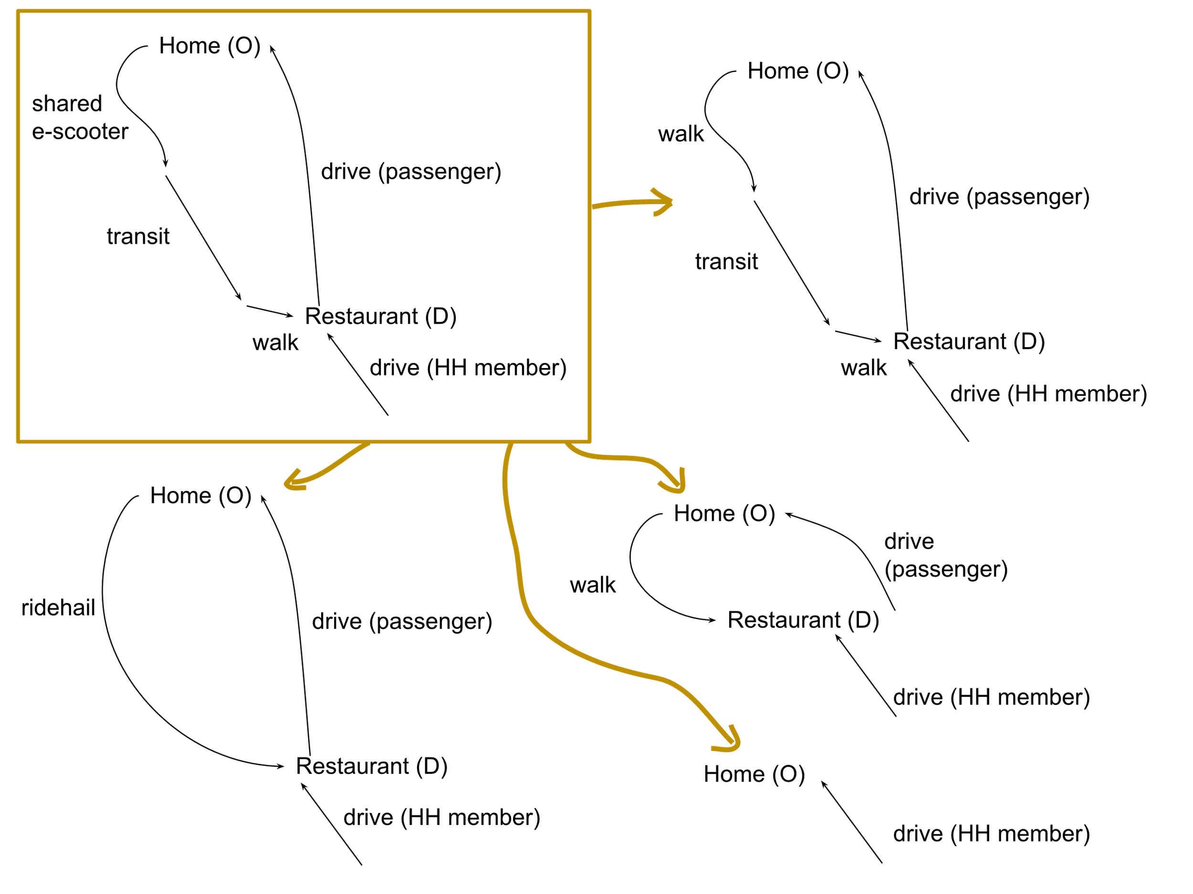
2,000 VMT
Reduced
35%
https://bicyclingplus.ucdavis.edu/
Notes:
Many surveys suggest dockless micromobility trips substitute for car travel roughly 35% of the time in US cities
Our modeling in the Sacramento region suggests a 1,000-vehicle system (pre-covid) resulted in 2,200 VMT reduced per day (ignoring operational VMT)
But even these estimates are problematic. Micromobility services can alter travel patterns beyond trip-level substitution (as illustrated in the bottom left)
What we need are more nuanced estimates of how travel changes because of micromobility services (something we are doing at UC Davis with longitudinal GPS travel diaries)
But even if we account for operational VMT, have better metrics travel substitutes and compliments, the potential of micromobility services is greater than we see today.
The future is uncertain, but micromobility services will be just one facet of a sustainable future, one that will require a lot more than scooter tech and MaaS platforms. Re-envisioning cities with improved access such as networked polycentric designs (such as that on the bottom right) with safe and comfortable infrastructure is necessary for unlocking the sustainability benefits of micromobility services.

