Slide 1
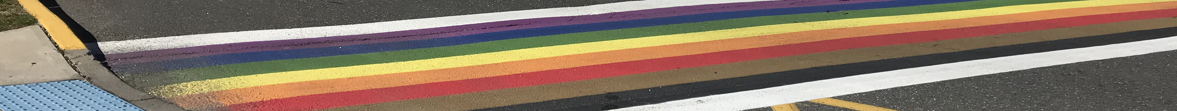
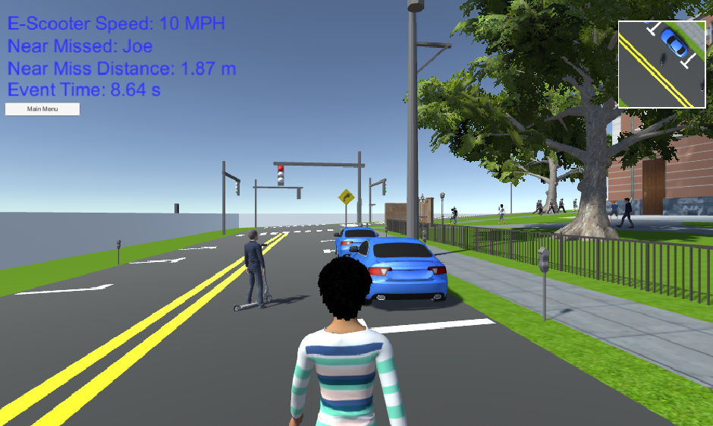
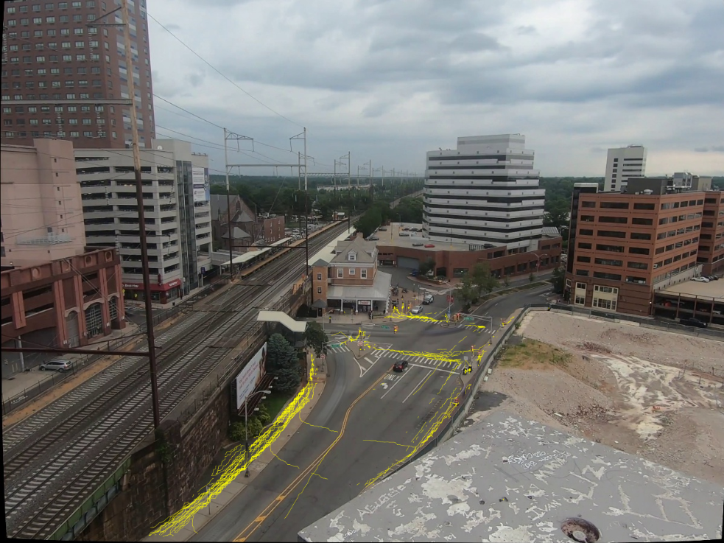
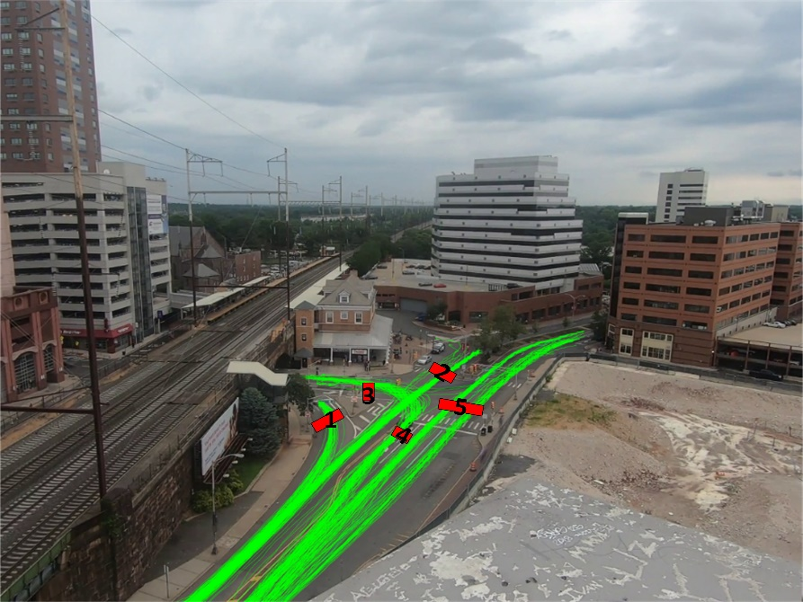
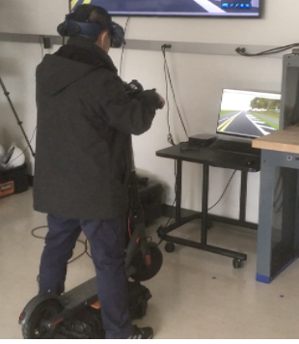
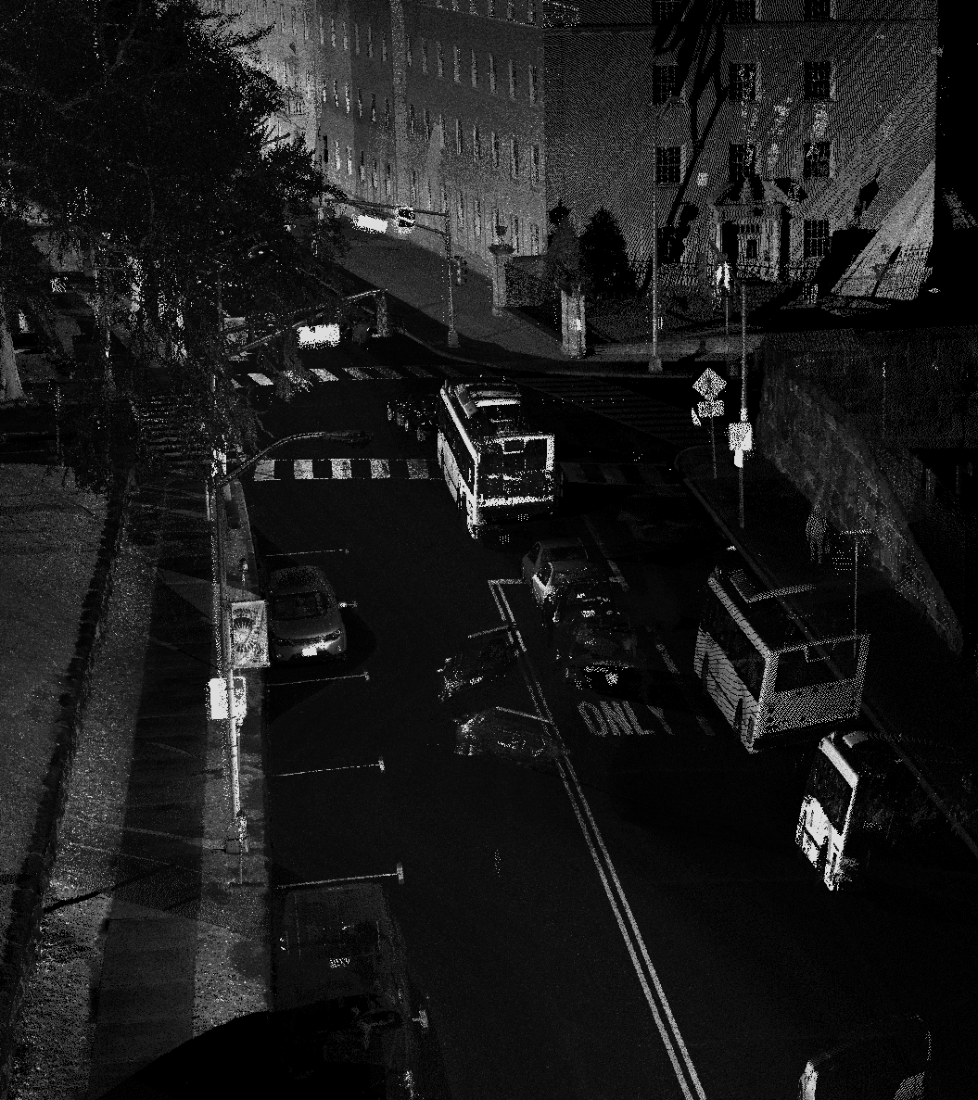
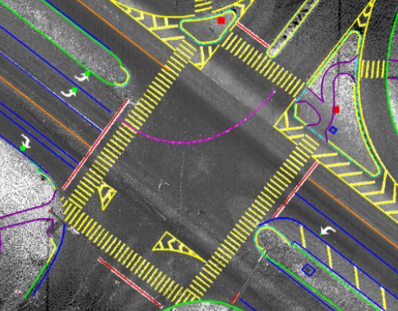
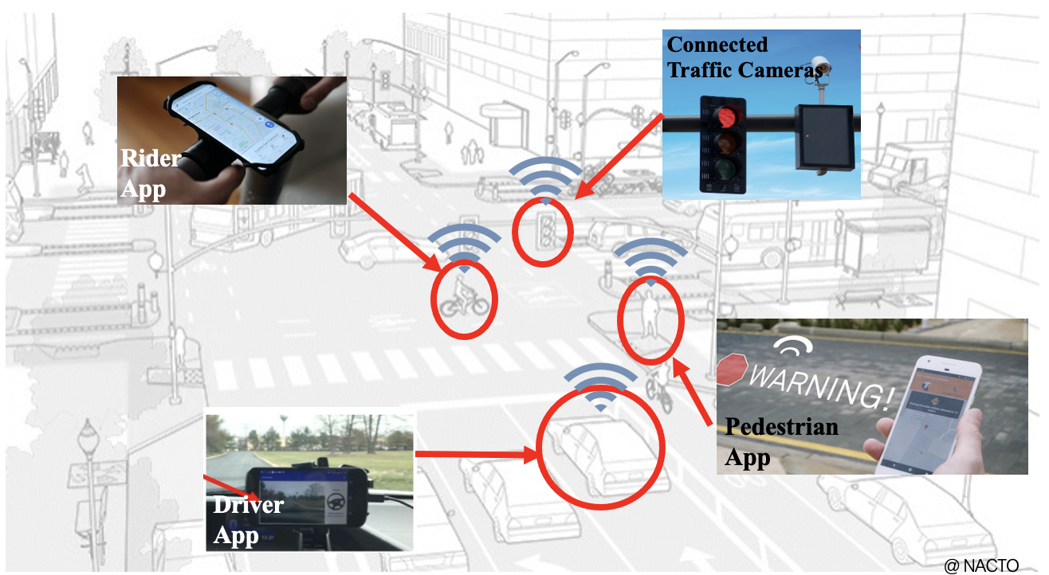
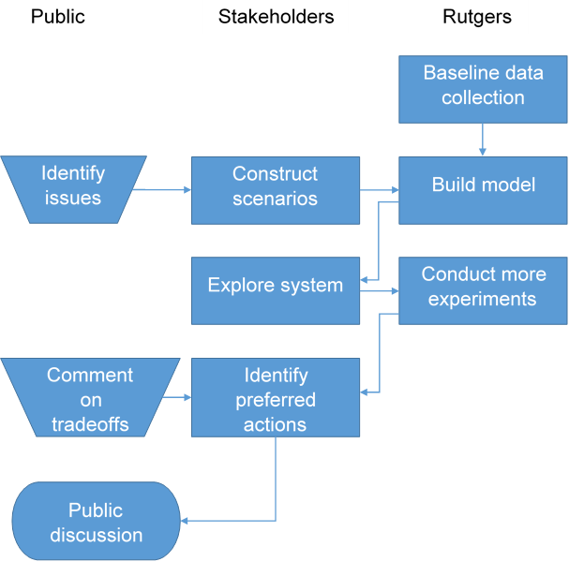
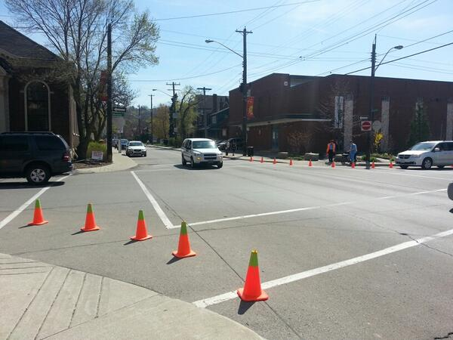
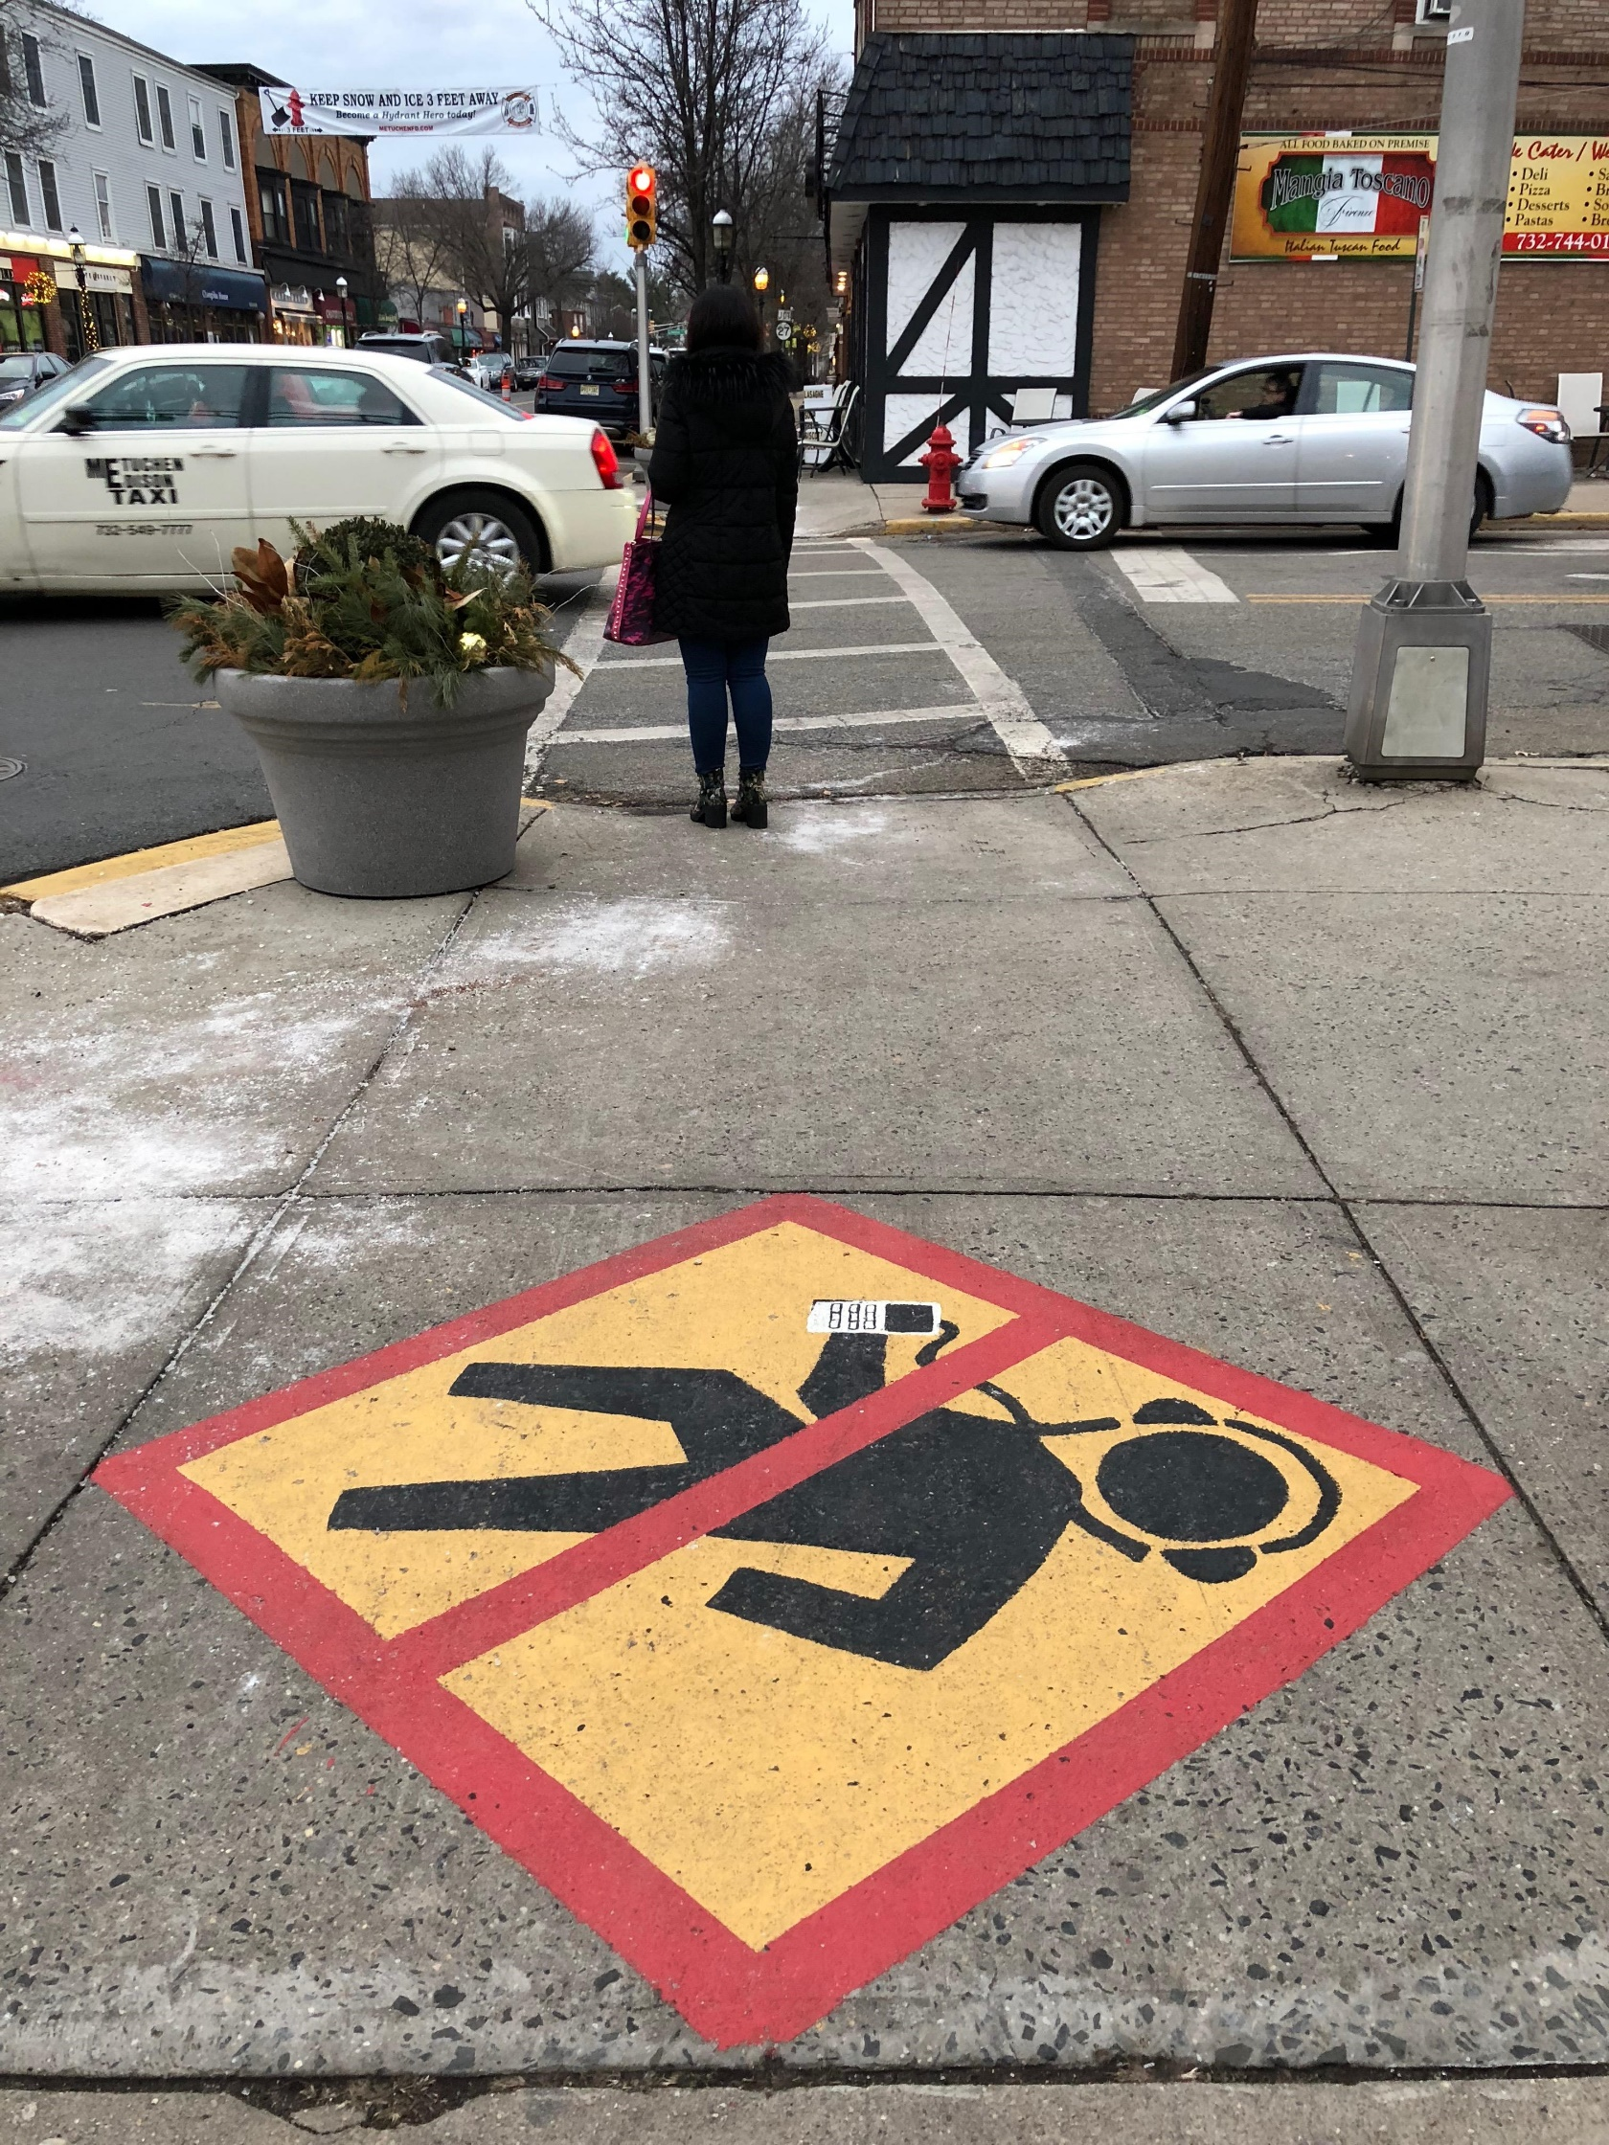

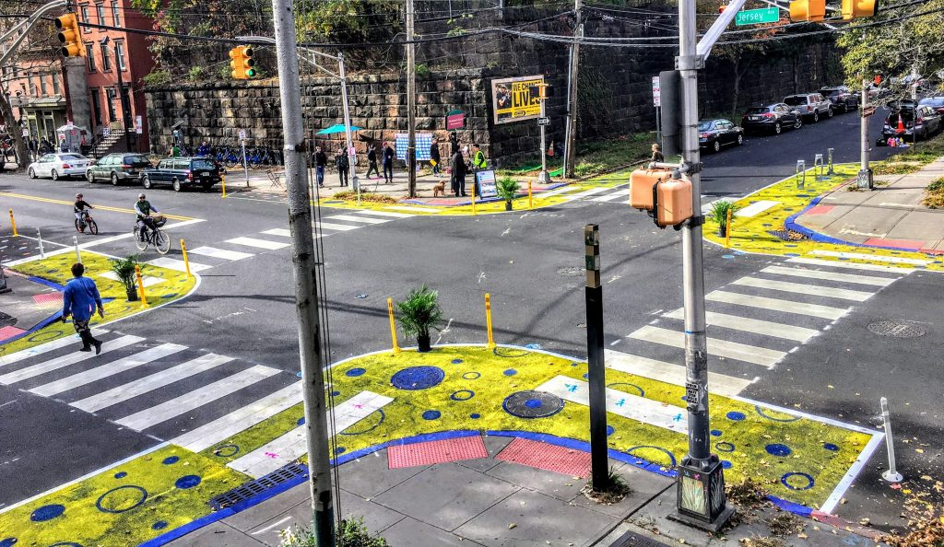


Making Micromobility Smarter and Safer
NSF Award #: 1951890 bloustein.rutgers.edu/micromobility
Rutgers Research Team
Project Overview
Roadway User Trajectory Prediction Using Computer Vision Techniques
VR Environment
Edward J. Bloustein School of Planning and Public Policy
Clinton Andrews, PhD, AICP
Kelcie Ralph, PhD
Robert Noland, PhD
Leigh Ann Von Hagen, AICP, PP
Department of Civil and Environmental Engineering
Jie Gong, PhD
Department of Computer Science
Dimitris Metaxas, PhD
Desheng Zhang, PhD
 | Problem Definition | Solution Generation
Technological Dimensions | Measure and warn near misses | Connect smart pedestrian, e-scooter, driver & intersection systems Develop an app for pedestrians, e-scooters, and drivers
Social Dimensions | Build consensus for public action | Encourage behavior change for all road users Redesign roadways
Pedestrian Trajectory
Vehicle Trajectory
Digital Twin Model of the Built Environment
Project Partners
Connected Solution for Micromobility Safety
Social Experiments
Community Engagement
The City of Asbury Park, NJ
Borough of Highland Park, NJ
The City of Hoboken, NJ
The City of New Brunswick, NJ
North Jersey Transportation Planning Authority (NJTPA)
Rutgers University Transportation Services
Veo
Tactical Urbanism
Behavioral Prompts

